Slide 1
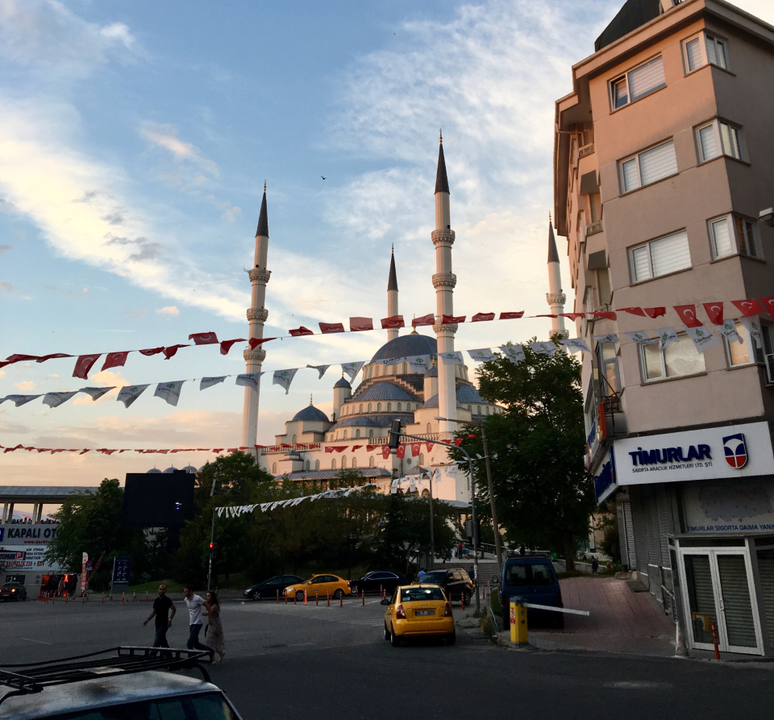
2022-23 Foreign Language & Area Studies Fellowships
Information Session

Slide 2
Goals of FLAS Fellowship
Assist in the development of knowledge, resources, and trained personnel for modern foreign language and area/international studies​
Stimulate the attainment of foreign language acquisition and fluency ​
Develop a pool of international experts to meet national needs​
Giselle Pagunuran Summer 2019
Language: Japanese

Slide 3
What is FLAS?
Foreign Language & Area Studies (FLAS) Fellowships support students taking less commonly taught languages and area studies coursework. This program provides both academic year and summer fellowships to graduate and undergraduate students.​

Slide 4
Eligibility​
Students must be a U.S. citizen by birth or naturalization, or a permanent resident.​
Students must be at the intermediate or higher level in their target FLAS language to be eligible.​
One exception: graduate students may take beginner level courses in a Less Commonly Taught Language (LCTL) if they have advanced skills in another language in that world region.​

Slide 5
Eligibility cont’d ​
For AY fellowships, graduate students must be enrolled in a UNC program of graduate or professional study by the start of the Fellowship, but may apply in advance of admissions notification.​
For Summer fellowships, you may be a graduating undergraduate as long as you delay graduation to August or are a prospective graduate student as long as you can demonstrate UNC graduate or professional school admission during the upcoming Fall. You may apply in advance of admissions notification.​
Use of funds for either fellowship in contingent upon acceptance to and enrollment in a full-time course of study at a FLAS-granting institution (typically, at UNC-CH). ​
FAFSA ranking will be reviewed as reported by the Office of Financial Aid.

Slide 6
NOTE on 2022-23 Fellowships
The UNC Area Studies Centers are in the process of applying to the US Department of Education for another round of FLAS grants to administer at UNC. Thus, the availability of academic year FLAS awards for 2022-23 is not yet guaranteed.
Summer 2022 awards will be available from the following centers:
African Studies Center
Carolina Asia Center
Center for European Studies
Institute for Study of the Americas

Slide 7
Summer Fellowships: LANGUAGE​
Summer FLAS Fellowships support for approved intensive summer language courses in the U.S. or abroad. ​
 | Stipends | Tuition & Fees
Graduate & Undergraduate Students | $2,500 | Up to $5,000
FLAS fellowships could affect financial aid packages, particularly for undergraduate students. We recommend that if awarded you contact the Office of Student Financial Aid to determine the fellowship’s effect on your financial aid package.

Slide 8
Summer Fellowships: LANGUAGE​
Overseas programs require U.S. Dept of Education approval which will be submitted by your Center’s FLAS coordinator.​
Please remember: You will apply to the program of study separately.
Programs must be 6-8 weeks in length.
​Programs must be 140 hours at the beginning and intermediate levels; or 120 hours at the advanced level.​
Programs must be credit-eligible even if you do not get UNC credit.
It is highly recommended that undergrads consult Study Abroad before deciding on a program.

Slide 9
Academic Year Fellowships:​ Area Studies and Language​
Academic year FLAS Fellowships provide a stipend plus support for tuition and fees.
Fellows are required to take at least one language and one area studies course each semester.​

Slide 10
Academic Year Fellowships:​ Area Studies and Language​
Academic Year Fellowships | Stipends | Tuition & Fees
Graduate Students | $15,000 | Tuition & Fees
Undergraduate Students | $5,000 | Up to $10,000
FLAS fellowships could affect financial aid packages. We recommend that if awarded you contact the Office of Student Financial Aid to determine the fellowship’s effect on your financial aid package.
If awarded, graduate students eligible for stipends above $15,000 need to submit letter of guarantee from their home department before accepting the award.
*The exact funding levels for 2022-23 have not yet been confirmed by the US DofE.

Slide 11
Application Process
Application Website:​
https://areastudies.unc.edu/flasunc
Statement of Purpose
Two recommendation letters
Language Evaluation

Slide 12
Deadline
The online application will be made available on December 1, 2021.​
The deadline for applications for Summer 2022 and Academic Year 2022-23 will be February 4, 2022. ​

Slide 13
Application Tips
Apply on time and carefully proofread.​
Demonstrate connections to your language and world region.​
Pick your recommenders carefully and notify them in advance of applying.​
If you have specific questions or concerns, meet with the FLAS coordinator of the Center(s) that you plan to apply to. ​

Slide 14
Contact Information
AFRICA
Ada Umenwaliri (adaozo@email.unc.edu)
ASIA
Kevin Fogg (kfogg@email.unc.edu)
EUROPE
Katie Lindner (klindner@email.unc.edu)
EASTERN EUROPE / RUSSIA / EURASIA
Adi Džumhur (dzumhur@email.unc.edu)
LATIN AMERICA AND CARIBBEAN
Beatriz Riefkohl Muñiz (riefkohl@email.unc.edu)​
MIDDLE EAST
Shai Tamari (tamari@email.unc.edu)

Slide 15
QUESTIONS?

