Slide 1
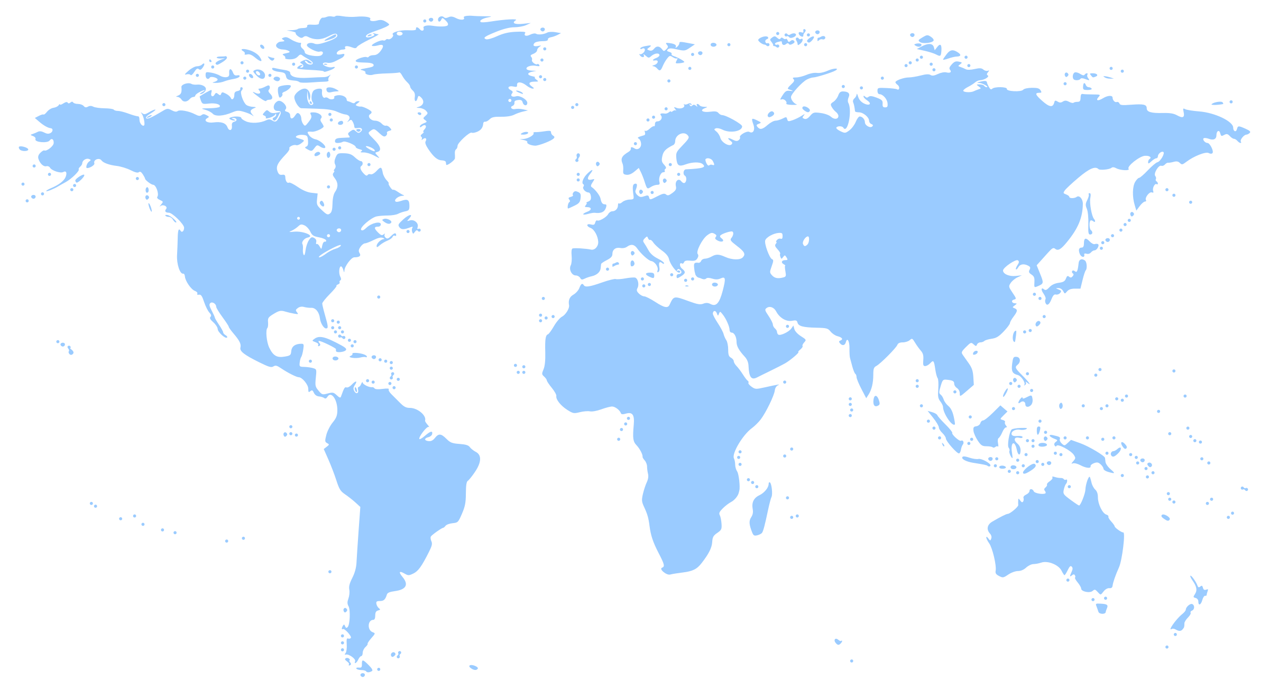
GLOBAL AREA STUDIES CENTERS at UNC-Chapel Hill and Duke University
The Global Area Studies Centers provide services and resources for instruction, learning and research related to global issues, world regions and modern foreign languages.
The centers place special emphasis on offering free resources and programs to educators.
Classroom Resources
Teacher Training
Teacher Travel
Student Engagement
African Studies Center
Carolina Asia Center
Center for Slavic, Eurasian, and East European Studies
Duke-UNC Consortium for Middle East Studies
Carolina Navigators (in the Center for Global Initiatives)
Center for European Studies
UNC-Duke Consortium in Latin American and Caribbean Studies
areastudies.unc.edu

Slide 2
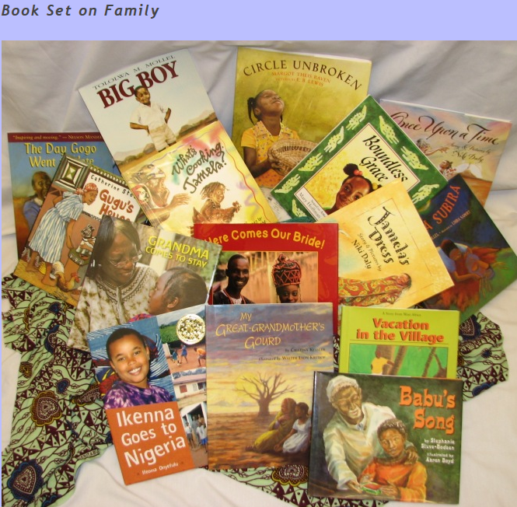
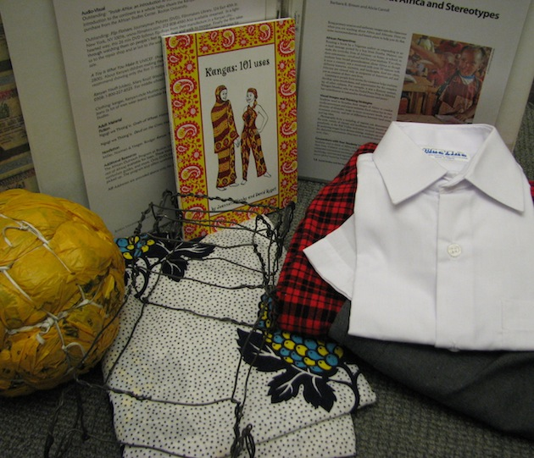
Resources and Initiatives
http://africa.unc.edu/outreach/index.asp The African Studies Center offers Elementary Book Sets, Culture Kits, and
initiatives for K-12 and CC Educators
Kenya Culture Kit contains Posters, Books, DVDs, Kenyan school workbooks, Boys and girls school uniforms, Household items including homemade toys, a broom, and Kenyan money.
Initiatives for the 2019-20 Academic Year Include:
Developing and piloting a curriculum on Africa (digitizing content for K-12 education)
Africa Week
International Women’s Day event
Africa Spring Conference
Six thematic seminar series (governance, human rights, arts)
Course development grant to faculty at UNC Chapel Hill, partner Minority Serving Institutions and Community Colleges

Slide 3
Carolina Asia Center
CAC supports educators and provides Asia-related resources for K-16 to promote conversations about Asia and cultural competency
Digital Resources https://carolinaasiacenter.unc.edu/outreach/
Lesson plan database for K-16
Book database for K-16
Professional development workshops/database
Teacher library with book sets for K-12 (2-4 week loaning period)
Workshops in collaboration with North Carolina Teaching about Asia
Upcoming workshop Sept 28, 2019 on Culture and Art in Japan (woodblock prints) held at UNC Fedex Global Education Center + visit to the Ackland Museum

Slide 4
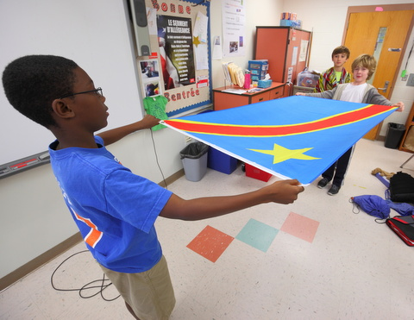
Carolina Navigators is a service-learning program that works with UNC students who have intercultural expertise, to create FREE global education resources for K-14 educators and students in NC. They create culture kits, videos, and virtual presentations. navigators.unc.edu/
Browse the Global Resource Finder!
Reserve a culture kit to use in your classroom!
Sign up to attend a Virtual Cultural Festival (November & April)!
Watch a global video on our YouTube Channel!
Sign up for the monthly newsletter for updates!
Watch the Program Video to learn more!-Short Story: Carolina Navigators

Slide 5
K-16 Outreach
EU2U Professional Development Trainings europe.unc.edu/eu2u/
Workshops on Contemporary Europe and Teaching the European Union (EU) offered as requested to
educators at K-12 schools, community colleges, HBCU/MSIs, four-year universities, professional schools, educational non-profits, and businesses
Develop ways to integrate Europe and the EU into your classroom or workplace
Contact Allison Haskins for information and scheduling
EU in NC Study Tour europe.unc.edu/eu-in-nc/
Two-day professional development experience about Europe and the EU for local educators
2020 dates coming soon!
Brussels Study Tour Grants
five-day professional development opportunity for K-12 teachers, Community College, and HBCU/MSI Educators to visit Brussels and learn about the EU
Grants provide reimbursement for one transatlantic flight up to $1000 and cover group hotel arrangements
Coming soon! information on June 2020 Study Tour and application europe.unc.edu/brussels/
Digital Resources europe.unc.edu/teach/
K-12 Teaching the EU Toolkits
K-16 Business Briefs
Infographics and information on current events
Check out our program of events! europe.unc.edu/events/
Sign up for our emails!
go.unc.edu/euronews
Contact: Allison Haskins, International Education Program Coordinator, ahaskins@unc.edu

Slide 6
UNC Center for Slavic, Eurasian, and East European Studies
Featured Resources:
Visual Guide to the Cold War // coldwar.unc.edu //
(a unique digital collection of political cartoons, photographs, propaganda posters, film clips, and other visual primary sources covering US-Soviet relations during the Cold War)
Teaching the Russian Revolution // guides.lib.unc.edu/1917 //
(a curated selection of multimedia primary sources explaining the causes along with the main actors and events of the Russian Revolution and its global significance)
We can assist with:
Curriculum design • Guest speakers in your classroom • Consultation and funding for events at your school (exhibits, performances, film screenings, etc.) • Materials for school media center
get in touch >> cseees@unc.edu
@cseees
@unc_cseees
cseees.unc.edu

Slide 7
Duke-UNC Consortium for Middle East Studies
Deepening understanding of the Middle East through professional development opportunities, classroom resources, and more.
Resources for Educators
Professional Development (workshops, webinars, teacher fellows programs, study tours)
Online Resources (Middle East Explained video series, lesson plans, etc.)
Culture Kits & Picture Book Sets
Speakers Bureau
Contact: Emma Harver, Outreach Coordinator, harver@email.unc.edu | 919-962-6732
ncmideast.org/outreach @DukeUNCConsortiumMidEastStudies @UNC_CMEIS @DukeMideast

Slide 8
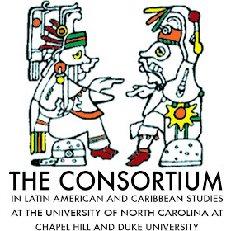
The Consortium in Latin American and Caribbean Studies at UNC-Chapel Hill and Duke University
The Consortium provides resources on Latin America and the Caribbean to K-16 educators in North Carolina and beyond.
Outreach efforts include:
Professional Development Workshops
Study Tours
K—12 Book Sets
Latin American Film Library
Culture Kits
For more information:
Corin Zaragoza Estrera, Outreach Coordinator czaragozaestrera@unc.edu
Web: jhfc.duke.edu/latinamericauncduke/outreach/k-16-educators
Facebook: UNC-Duke Consortium in Latin American & Caribbean Studies
Twitter: @isa_clacs

